Slide 1
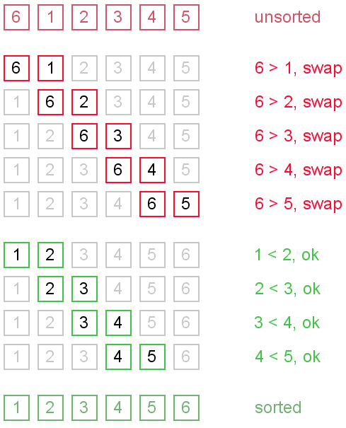
4.3.5 Sorting Algorithms
Syllabus Details
4.3.5 Sorting algorithms
4.3.5.1 Bubble sort
4.3.5.2 Merge sort
Preliminary Multiple Choice Questions
Attempt the Preliminary Multiple Choice questions posted on Teams.
4.3.5.1 Bubble Sort
Key point
Bubble Sort
Watch the animation posted on Teams.
Bubble sort is a simple sorting algorithm but not very efficient one. It belongs to a family of sorting algorithms called “exchange” or “transposition” sorts.
In an exchange sort, pairs of items that are out of order are interchanged until no more out of order pairs exist.

Slide 2
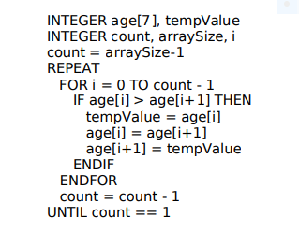
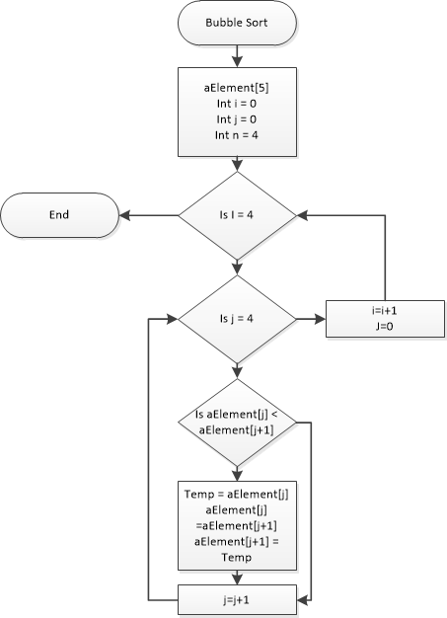
Algorithm for Bubble Sort
Examples of the algorithm in different forms

Slide 3
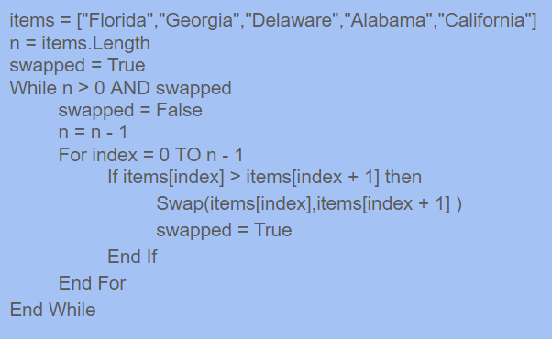
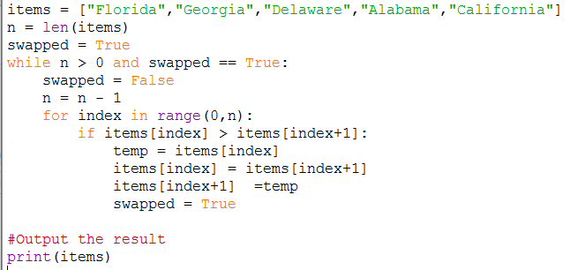
Algorithm for Bubble Sort
Pseudocode example using a list.
Python code for the above example.

Slide 4
Algorithm for Bubble Sort
Task
Work out the time complexity for the algorithm below. Do it for best, average and worst scenario. To help you complete the step through table on the next page.
The best case scenario is O(N)
Worst case is O(N^2)
Average case is O(N^2)
Support
PGonline - Section 8 p 235 LMC - Paper 1 theory p164
Brian Faure Video 1 Mr BrownCS Video 1

Slide 5
Algorithm for Bubble Sort
ABCDEFG
Task
Index | 0 | 1 | 2 | 3 | 4
Step 1 | Compare Florida and Georgia. No swap needed.
 | -> Florida | George<- | Delaware | Alabama | California
Step 2 | Compare And swap
 | F | -> G | D <- | A | C
Step 3 | Compare And swap
 | F | D | -> G | A <- | C
Step 4 | Compare And swap
 | F | D | A | ->G | C<-
Step 5 | Compare And swap
 | ->F | D<- | A | C | G
Step 6 | Compare And swap
 | D | ->F | A<- | C | G
Step 7 | Compare And swap
 | D | A | ->F | C<- | G
Step 8 | No swap needed.
 | D | A | C | ->F | G<-

Slide 6
Algorithm for Bubble Sort
Task
Step 9 | Compare and swap
 | ->D | A<- | C | F | G
Step 10 | Comapre and swap
 | A | ->D | C<- | F | G
Step 11 | List sorted
 | A | C | D | F | G
Programming Task
Code the bubble sort algorithm to sort a given list of integers in ascending order.
Apply it to sorting the following lists of integers 23 17 45 6 78 21 into ascending order.
Alter the code so that sorts into descending order.
Alter your program so that it counts and totals each of the following:
the number of comparisons
the number of exchanges
the number of passes (outer loop)
The result of each should then be written to the screen once sorting is complete.
Alter your code so that a list of numbers in ascending order is sorted into descending order. Run your code for the following list numbers:
n = 5
n = 10
n = 100
n = 1000
n = 10000

Slide 7
Bubble Sort Investigation
Programming Task
Document your findings from sorting the different lists using your Bubble Sort algorithm.
List 1: [23,67,89,12,3456,12,34,567,12]
List 2: [1,2,3,4,5,6,7,8,9,10]
List 3: [10,2,3,4,5,6,7,8,9,1]
List 4: [1,2,3,4,5,45,67,23,34,2]
List 5: [456,24,56,12,26]
Question 1
Which list was the fastest list to SORT and why?
List 2 its allready sorted
Question 2
Which list was the slowest list to SORT and why?
List 3 it needs to do the max number of passes and has the most comparisons
Question 3
State the weaknesses you think it has.

Slide 8
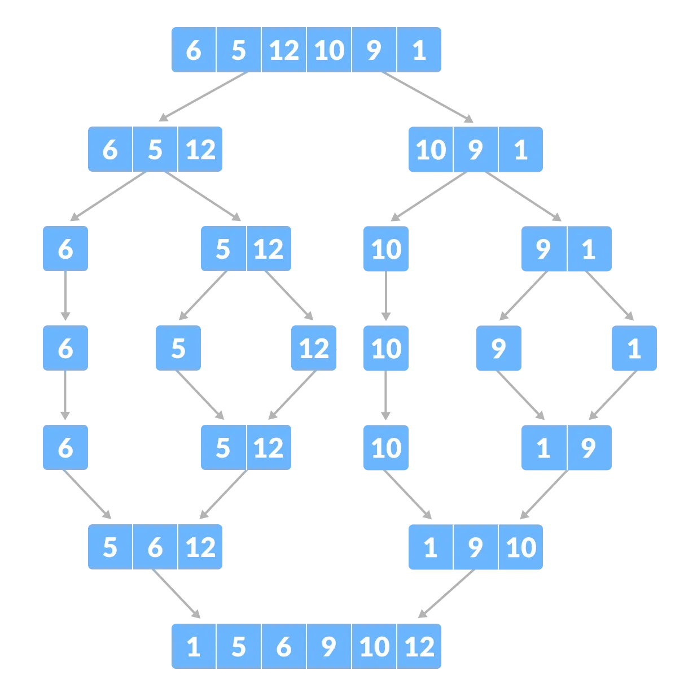
4.3.5.2 Merge Sort
Key point
Merge Sort
Watch the animation posted on Teams.
Merge sort is an example of a divide and conquer algorithm, meaning that the problem of sorting an unsorted lists of items is solved by dividing the problem into subproblems, solving the subproblems and then merging the results to produce the sorted list
Support
Michael Sambol Video 1 Mycodeschool Video 1

Slide 9
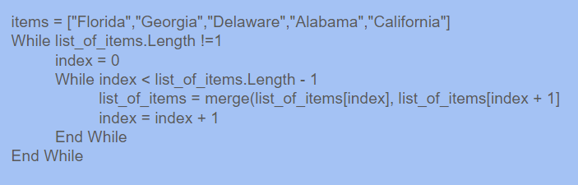
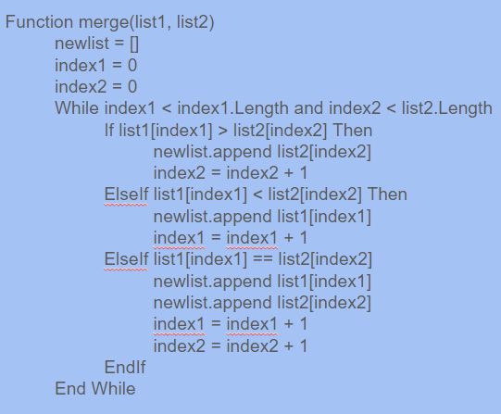
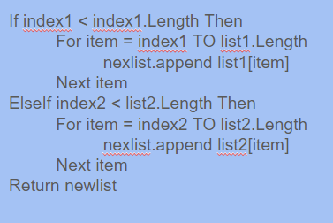
Algorithm for Merge Sort
Pseudocode example using a list.

Slide 10
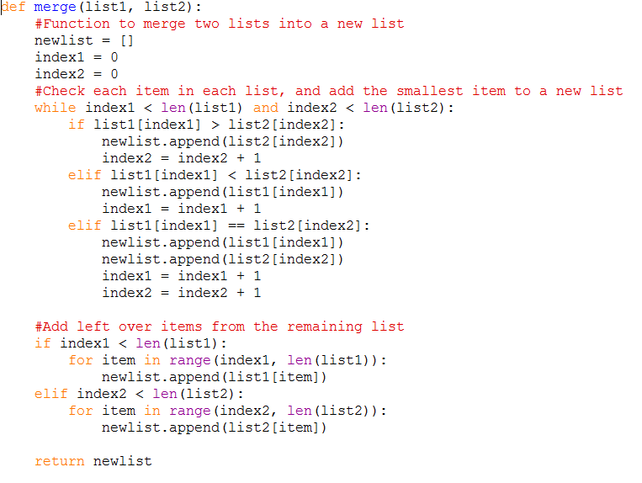
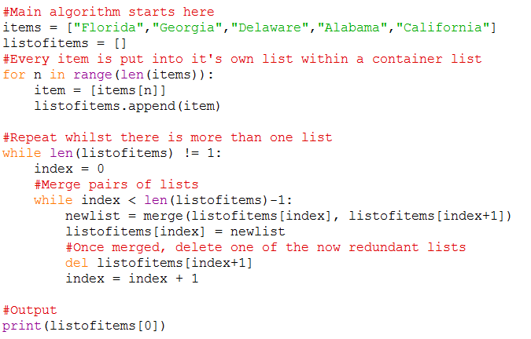
Algorithm for Merge Sort
Python example using a list. - ITERATIVE

Slide 11
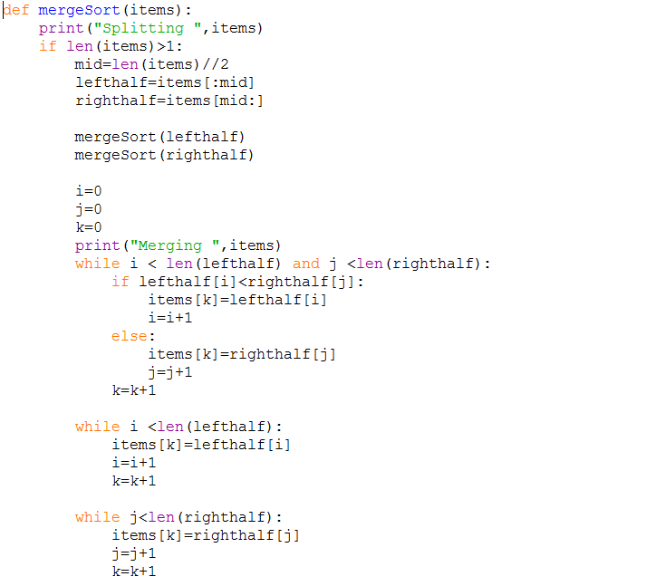

Algorithm for Merge Sort
Python example using a list. - RECURSIVE
Work out the time complexity for the algorithm below. Do it for best, average and worst scenario.
O(n logn)

Slide 12
Algorithm for Merge Sort
Programming Task
Code the Merge Sort algorithm to sort a given list of integers in ascending order.
Apply it to sorting the following lists of integers 23 17 45 6 78 21 into ascending order.
Alter the code so that sorts into descending order.
Alter your program so that it counts and totals the number of layers in the merge sort
The total should then be written to the screen once sorting is complete.
Alter your code so that a list of numbers in ascending order is sorted into descending order. Run your code for the following list numbers:
n = 5
n = 10
n = 100
n = 1000
n = 10000
Do this for both the iterative and recursive versions.
Support on time complexity
PixelYogi Video 1
Check your understanding
Attempt the multiple choice questions posted on Teams.

Slide 13
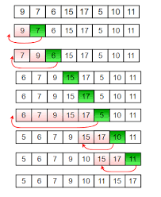
Insertion Sort - NOT ON THE SYLLABUS
Key point
InsertionSort
Watch the animation posted on Teams.
Insertion sort is a simple sorting algorithm that considers one element at a time in an array of data, and moves that item into its correct place, shifting all other elements along as it does so.
Task
In the box below, write notes about how insertion sort works.

Slide 14
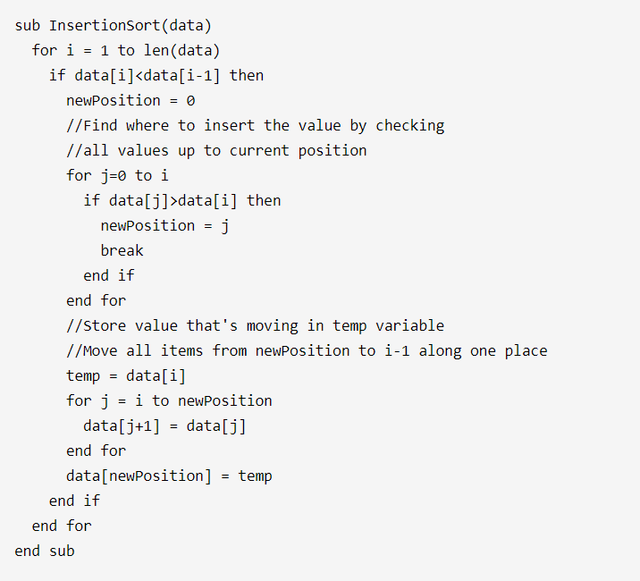
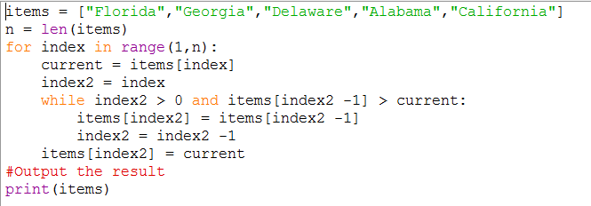
Algorithm for Insertion Sort - NOT ON THE SYLLABUS
Pseudocode example using a list.
Python code for the above example.

Slide 15
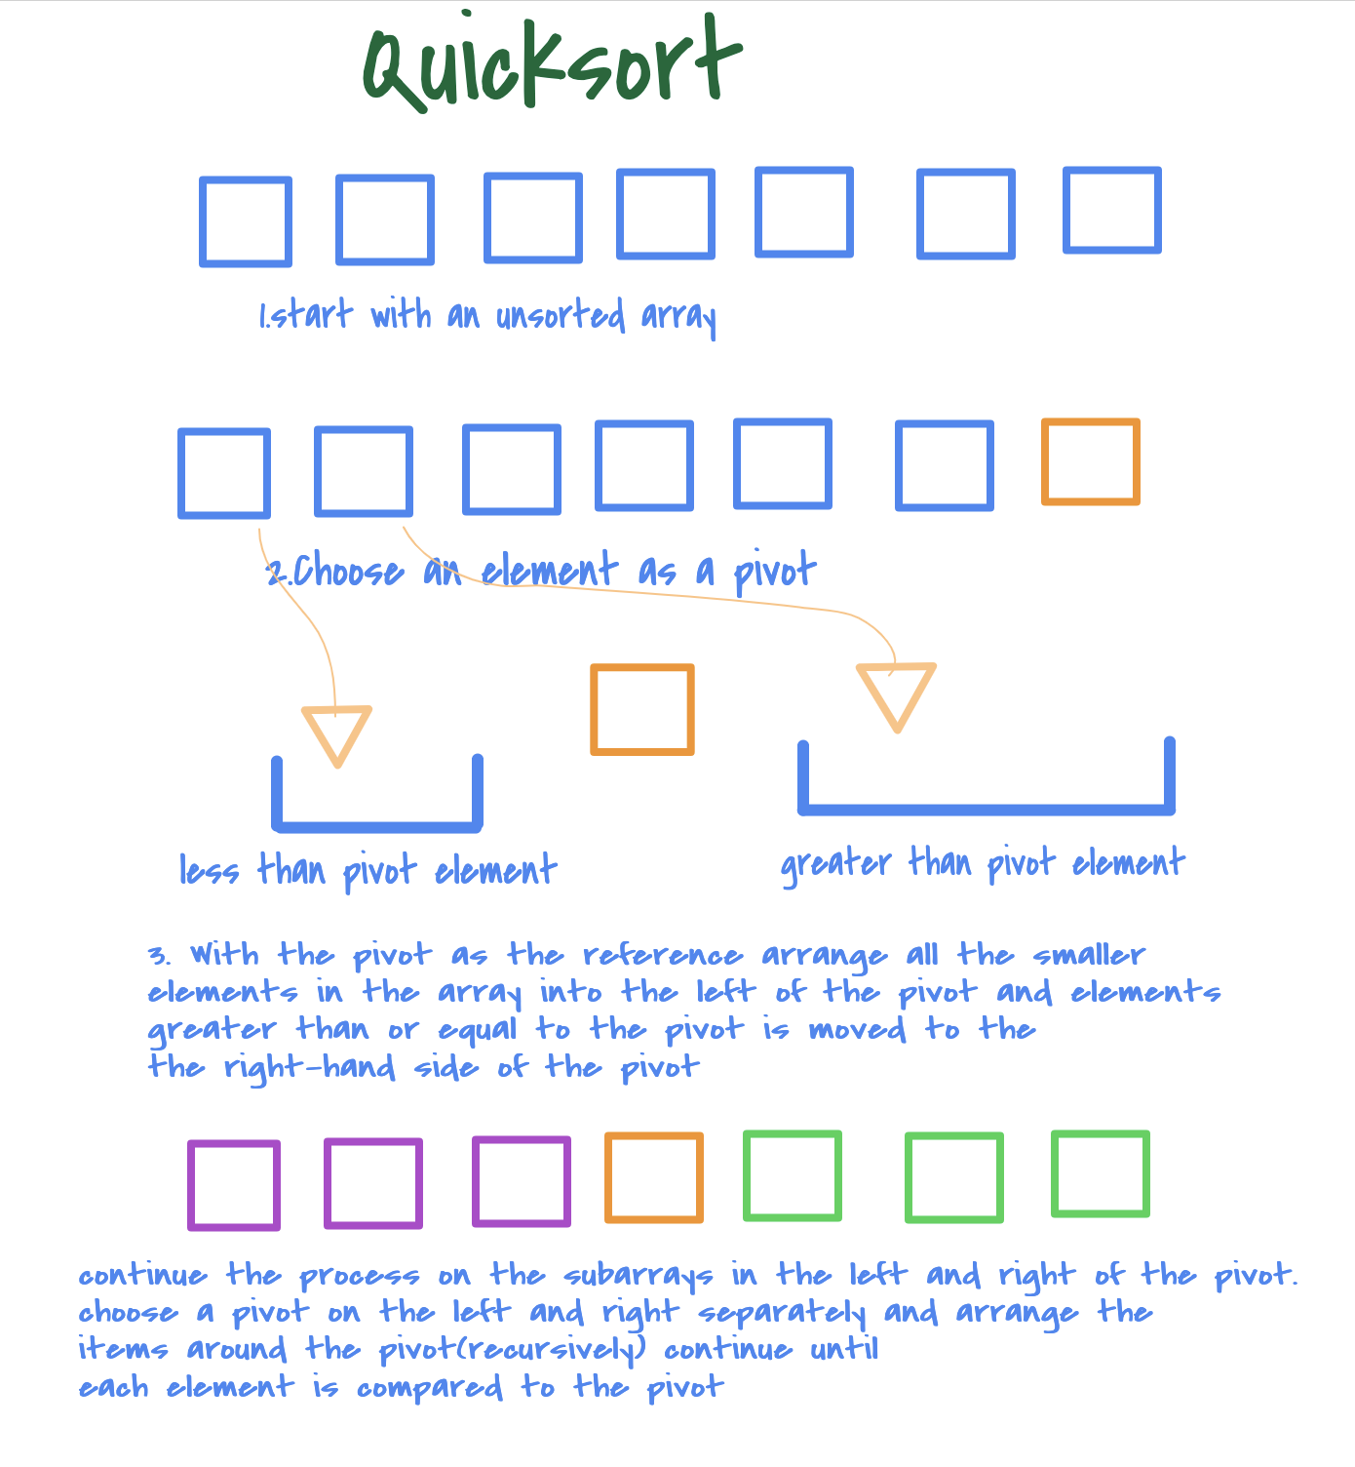
Quicksort - NOT ON THE SYLLABUS
Key point
Quicksort
Watch the animation posted on Teams.
Like Merge Sort, QuickSort is a Divide and Conquer algorithm. It picks an element as a pivot and partitions the given array around the picked pivot. There are many different versions of quickSort that pick pivot in different ways.
Task
In the box below, write notes about how insertion sort works.

Slide 16
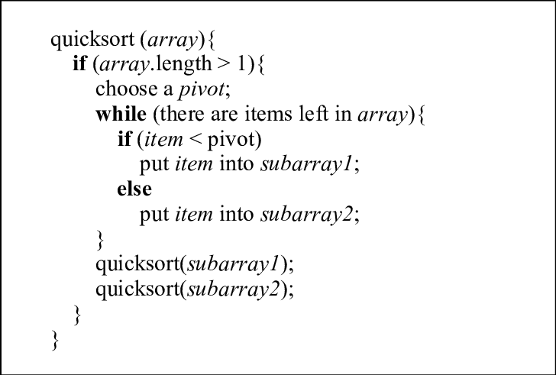
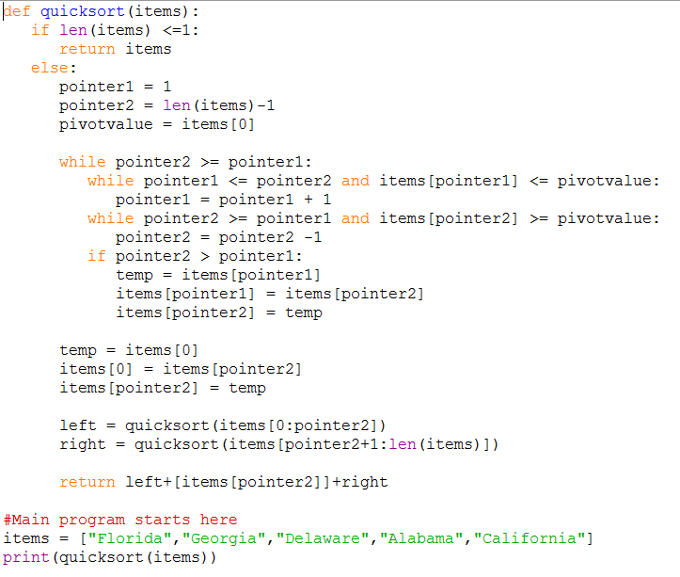
Algorithm for Quicksort - NOT ON THE SYLLABUS
Pseudocode example using a list.
Python code for the above example.

Slide 17
Vocabulary
Term | Description

Slide 18
Vocabulary
Term | Description

Slide 19
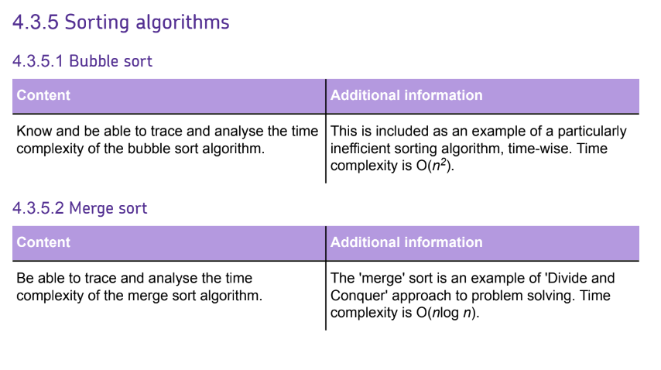

Slide 20




Useful links
Video 1 - Craig N Dave Bubble Sort Youtube video
Video 2 - Craig N Dave Merge Sort Youtube video
Video 3 - Kite 3 levels of sorting algorithms Youtube video
Website 1 - Isaac Computer Science website - section on sorting algorithms
Video 1 | Video 2 | Video 3 | Website 1
Action Plan

